Slide 1



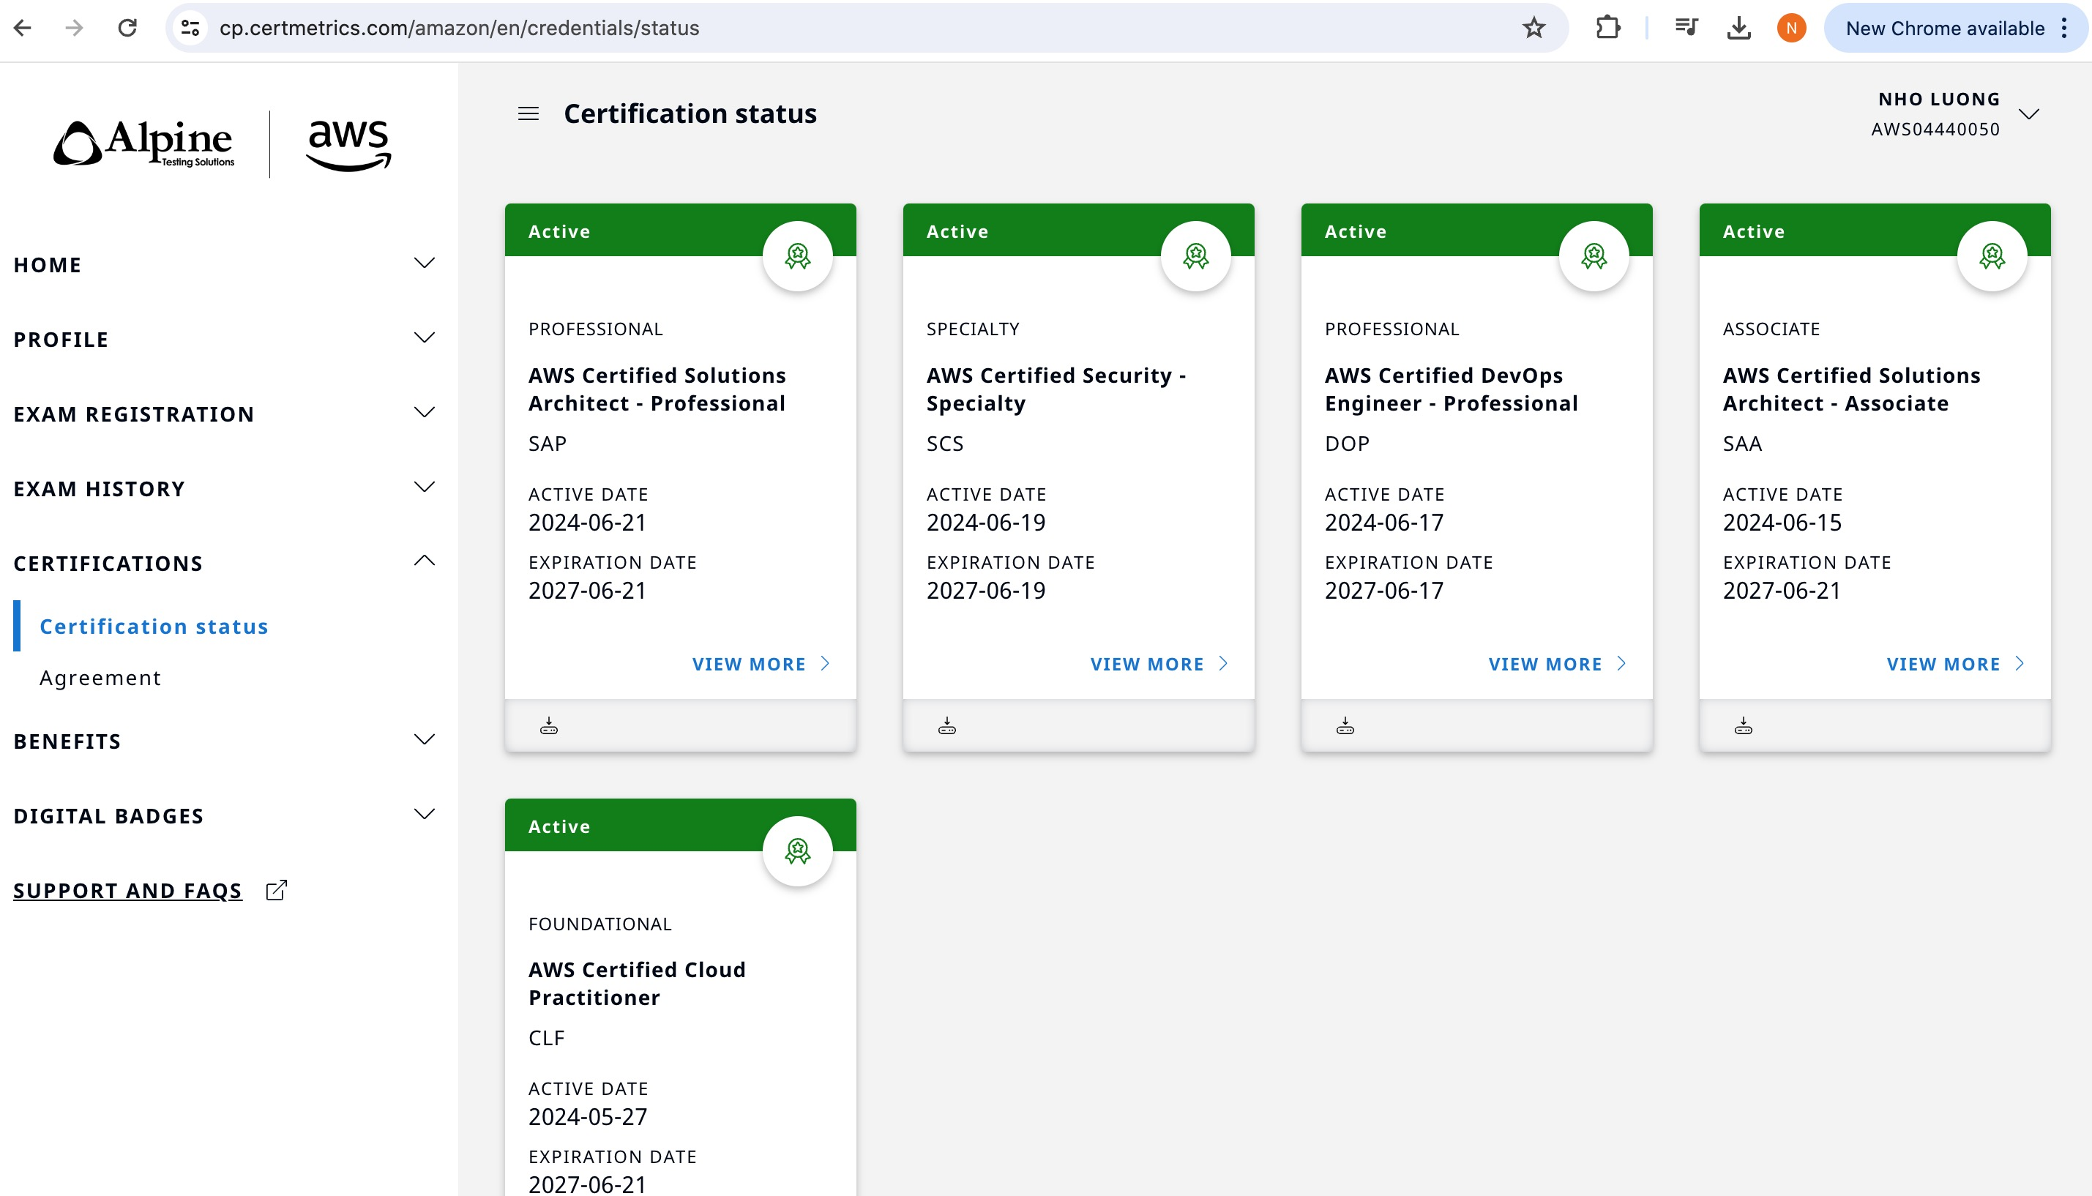
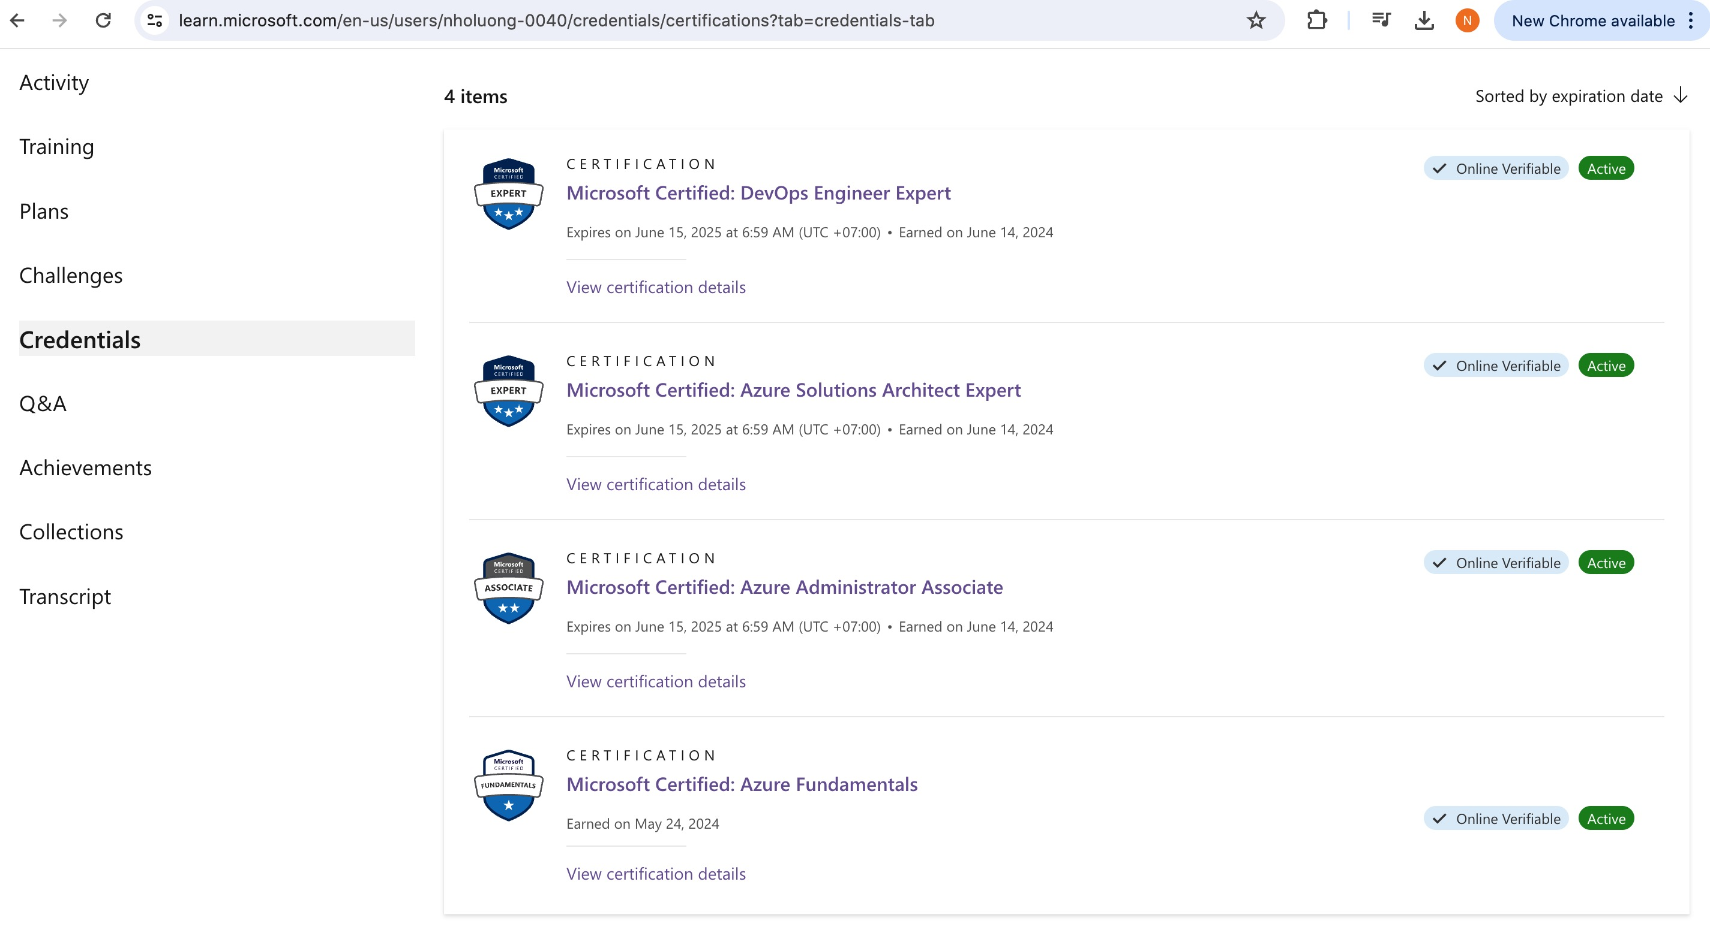
Using the Template Resource
Author: Nho Luong
Skill: DevOps Engineer Lead

Slide 2


EXERCISE
Using the Template Resource
Adding all the information into the recipe did make it hard to read.
Objective:
❑ ❑ ❑ ❑ ❑
Create a template with chef generate Define the contents of the ERB template Change the file resource to the template resource Update the cookbook's version number Apply the updated recipe and verify the results
Author: Nho Luong
Skill: DevOps Engineer Lead

Slide 3

Removing the file Resource
~/cookbooks/workstation/recipes/setup.rb # ... PACKAGE RESOURCES ...
file '/etc/motd' do content "Property of ...
IPADDRESS: #{node['ipaddress']}
HOSTNAME : #{node['hostname']}
MEMORY CPU " end
: #{node['memory']['total']} : #{node['cpu']['0']['mhz']}
Author: Nho Luong
Skill: DevOps Engineer Lead

Slide 4
Changing from file to template Resource
~/cookbooks/workstation/recipes/setup.rb # ... PACKAGE RESOURCES ...
template '/etc/motd' do source 'motd.erb' end
Author: Nho Luong
Skill: DevOps Engineer Lead

Slide 5
EXERCISE
Cleaner Recipes
This is a change to the cookbook so it is time to update the version again.
Objective:
✓ ✓ ✓ ✓ ✓
Create a template with chef generate Define the contents of the ERB template
Change the file resource to the template resource
Update the cookbook's version number Apply the updated recipe and verify the results
Author: Nho Luong
Skill: DevOps Engineer Lead

Slide 6
Updating the Cookbook's Version Number
~/cookbooks/workstation/metadata.rb name 'workstation’
maintainer 'The Authors'
maintainer_email 'you@example.com'
license 'all_rights'
description 'Installs/Configures workstation'
long_description 'Installs/Configures workstation'
version '0.2.1'
Author: Nho Luong
Skill: DevOps Engineer Lead

Slide 7
EXERCISE
Cleaner Recipes
This is a change to the cookbook so it is time to update the version again.
Objective:
✓ ✓ ✓ ✓ ✓
Create a template with chef generate Define the contents of the ERB template
Change the file resource to the template resource
Update the cookbook's version number Apply the updated recipe and verify the results
Author: Nho Luong
Skill: DevOps Engineer Lead

Slide 8

Applying the Updated Cookbook
> sudo chef-client --local-mode --runlist "recipe[workstation]"
- workstation (0.2.1) Compiling Cookbooks... Converging 2 resources Recipe: workstation::setup * yum_package[tree] action install (up to date) * template[/etc/motd] action create (up to date)
Running handlers: Running handlers complete Chef Client finished, 0/2 resources updated in 12 seconds
Author: Nho Luong
Skill: DevOps Engineer Lead

Slide 9
Verifying the Contents of the MOTD File
> cat /etc/motd
Property of ...
IPADDRESS: 172.31.57.153 HOSTNAME : ip-172-31-57-153
MEMORY CPU
: 604308kB : 1795.673
Author: Nho Luong
Skill: DevOps Engineer Lead

Slide 10
EXERCISE
Cleaner Recipes
This is a change to the cookbook so it is time to update the version again.
Objective:
✓ ✓ ✓ ✓ ✓
Create a template with chef generate Define the contents of the ERB template
Change the file resource to the template resource
Update the cookbook's version number Apply the updated recipe and verify the results
Author: Nho Luong
Skill: DevOps Engineer Lead

Slide 11

DISCUSSION
Discussion
What is the benefit of using a template over defining the content within a recipe? What are the drawbacks? What are the two types of ERB tags we talked about? What do each of the ERB tags accomplish?
Author: Nho Luong
Skill: DevOps Engineer Lead

Slide 12

Thank You
Author: Nho Luong
Skill: DevOps Engineer Lead

